Slide 1
HEY BUD
An interactive audiobook app for drivers.
By FamJam: Jacky Fong, Christine Pham, and Jeanine Looman

Slide 2

Whoa!
A hands-free app where you choose your own adventure while you drive??

Slide 3
Table of Contents
01
02
03
04
Website
HeyBud Algorithm
.. and our plan for collecting stories
The programming behind the game
Story Preview
Endgoal
Try it yourself!
Everything all at once, plus a little bit more

Slide 4
01
Website
.. and our plan for collecting stories

Slide 5

Collecting Stories
Anyone can contribute, and our libraries are organized by story categories & popularity.

Slide 6
02
HeyBud Algorithm
The programming behind the game

Slide 7
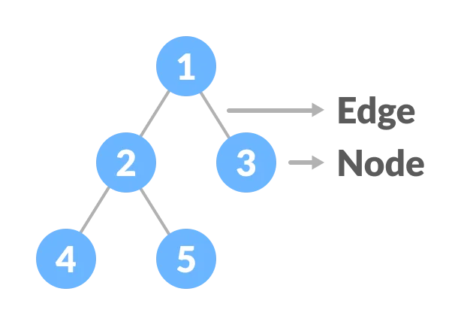
Story Maker
Intuitive drag and drop interface to aid HeyBud contributors.
Action
Story

Slide 8
03
Story Preview
Try it yourself!

Slide 9
04
Endgoal
Everything all at once, plus a little bit more

Slide 10
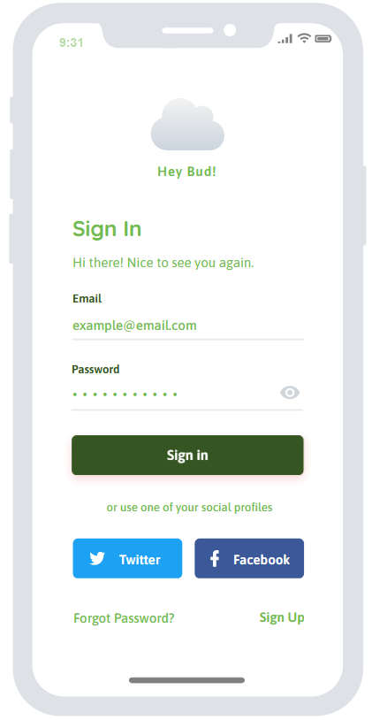
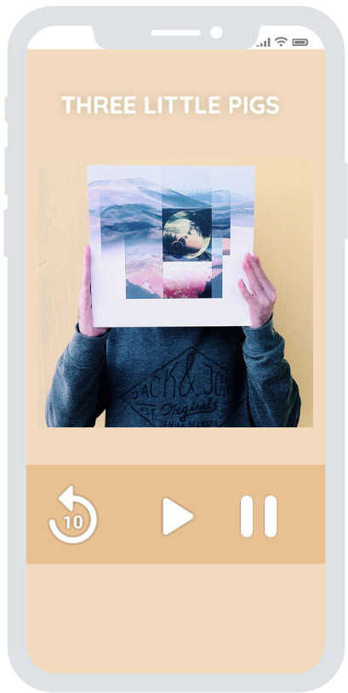
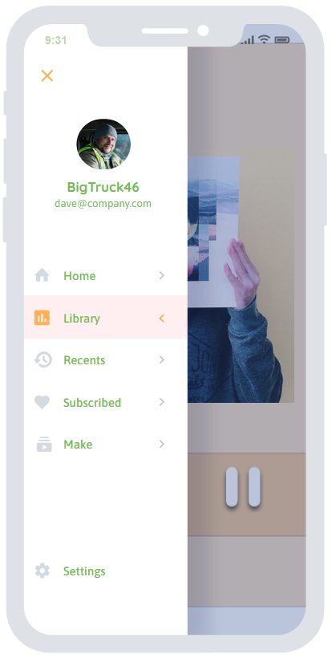
Our (Future) App
Notes:
Complete with a driving mode for a fully hands off experience, the app will autoplay stories and generate a playlist based on a users interests. Users can download playlists so that they can play the game wherever the road takes them.

Slide 11
Thanks!
Do you have any questions?
Please keep this slide for attribution

Slide 12
References
PowerPoint Template created by SlidesGo
Icons by FlatIcon
Graphical story making interface includes code from https://codepen.io/ross-angus/pen/VwLWqdL
Story idea from the Hobbit by JRR Tolkien

